Slide 1
EUROPEAN TERRITORIAL COOPERATION PROGRAME
GREECE – ITALY 2007 - 2013
Improving governance, management and sustainability of rural and coastal protected areas and contributing to the implementation of the Natura 2000 provisions in IT and GR
BIG –
Dr. Maurizio Pinna,
Researcher of Ecology, University of Salento (Italy).
Email: maurizio.pinna@unisalento.it
Phone: +390832298604
Skype: maupinna2008
Kick Off meeting – Corfù, 28 May 2014

Slide 2
EUROPEAN TERRITORIAL COOPERATION PROGRAME
GREECE – ITALY 2007 - 2013
Partnership
Leader partner (P1) Region of Ionian Islands/ Ionian University, Dept. of Informatics
Partner 2 Region of Western Greece
Partner 3 Region of Epirus
Partner 4 Ionian University, Dept. of Informatics
Partner 5 Technological Educational Institute Of Epirus
Partner 6 Apulia Region – Parks and Biodiversity Office
Partner 7 Province of Brindisi
Partner 8 University of Salento, Department of Biological and Environmental Sciences and Technologies (DiSTeBA)
Partner 9 Mediterranean Agronomic Institute of Bari (MAIB)

Slide 3
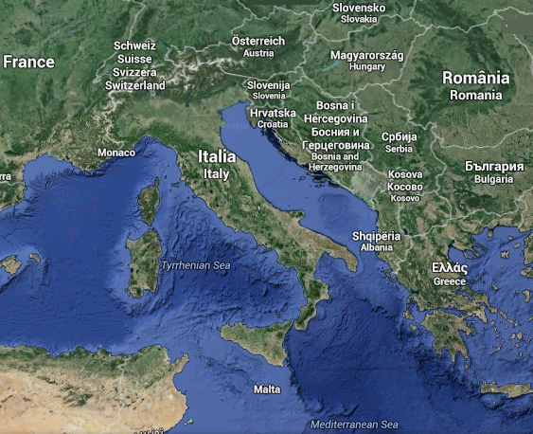
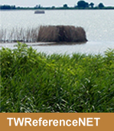
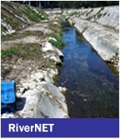
Partner 8 University of Salento (DiSTeBA)
ECOLOGY UNIT (DiSTeBA)
The Ecology Unit of the University of Salento develops experimental researches on aquatic ecosystems (freshwater - transitional - marine) focusing on biodiversity architecture and organization in relation with ecosystem functions and properties, including biomonitoring. The areas of interests cover the span from addressing individual level and processes to decoding patterns and processes, allowing to give basic knowledge to ecosystem management, spatial planning and scenarios in the context of climate changes and biodiversity conservation.
All staff and more information at www.ecology-unit.unisalento.it
LECCE

Slide 4
Key dates
Start date project : 1th Gennary 2014
Deliverable: _________2014
Update for final draft at ________2015
Final date project 31th December 2015

Slide 5
OBJECTIVE OF “BIG”
Improve governance, management and sustainable valorization of coastal and rural protected areas and contributing to the implementation of the Natura 2000 provisions in GR and IT
Strengthening and improving cooperation among regional administrations to further monitor Natura 2000 species and habitats and to set environmental measures for the next programming period. This aims will address at networking, setting common standards for biodiversity monitoring, creating regional databases and information system, and setting measures based on the updated biodiversity status (also thanks to the link with LifeWatch that enables a wider overview about biodiversity in EU)
Setting cross-border strategies and supporting decision-makers for management and valorization of protected areas and Natura 2000 sites. This includes the definition of guidelines which has already been developed in other projects but needs to be updated and upgraded,the realization and implementation of decision-makers support tools as well as the requalification of managers of protected areas
Developing coordinated concrete actions for the management and valorization of pilot rural and coastal ecosystems, that consists of on-the-ground interventions in Greek and Italian parks and/or Natura 2000 sites
Promoting sustainable tourism in protected areas via networking, implementation of concrete actions and transfer of best practices. This foresees the improvement and animation of existing pedestrian, cycling and local food paths in order to create a GR-IT common route for sustainable tourism in protected areas, the realization of a cross-border portal for touristic promotion, and finally the promotion of best practices about the European Charter of sustainable tourism in protected areas

Slide 6
Budget: 445.000,00€
WP1 Management & Coordination (Budget: 25.000,00€)
WP2 Information & Publicity (Budget: 14.900,00€);
WP3 Strengthening of the regional observatories on biodiversity in Greece and in Italy through the establishment of a network of local authorities (Budget: 94.800,00€);
WP4 Common trans-boundary strategies for the sustainable management and valorization of natural resources (Budget: 230.300,00€);
WP5 Valorization and sustainability of the protected areas through concrete and pilot actions with the involvement of society/general public about coastal and marine ecosystems (Budget: 80.000,00€);
Budget Partner 8 University of Salento (DiSTeBA)

Slide 7
Work Package 1
ACTION 1.2
Project coordination meetings
DELIVERABLE
n. 5 minutes of the project coordination meetings
CONTRIBUTION TO DELIBERABLE
Participation in n. 5 coorditnation meetings
ACTION 1.3
Project management and external audit
DELIVERABLE
n. 5 progress reports & n. 8 auditing report
CONTRIBUTION TO DELIBERABLE
Partner contribution to the progress report & Drafting and sending to the LP the auditing reports

Slide 8
Work Package 2
ACTION 2.3
Kick-off and final meeting
DELIVERABLE
Kick-off and final meeting
CONTRIBUTION TO DELIBERABLE
Participation in the kick-off and final meeting
ACTION 2.2
Publications, Photodocumentaries and Website
DELIVERABLE
Guidelines for the management and valorization of Protected Areas & Photodocumentary (Apulia) & website
CONTRIBUTION TO DELIBERABLE
Editing and printing the guidelines for the management and valorization of Protected Areas & creation and printing of a bilingual photo documentary for the Natura 2000 Areas & updating of the project website
Creating a photo-documentary of the main species of flora and protected species under Directive 92/43/EEC and 79/409/EEC that are found in protected areas of the Puglia region, in particular in coastal wetlands
STARTING STEP
Updating the results on the website, specially created, which will last for the entire period of the project
The activities, expected by Action 2.2, is part of promotional activities for the BIG project, and aims to make available to the public information on the main findings of the Strategic Project BIG

Slide 9
Work Package 3
ACTION 3.1
Creation of a trans-boundary network among regional/local authorities and scientific institutions for the management, governance and valorization of protected areas and setting of priorities and measures of the 2014-2020 programming period
DELIVERABLE
Report about networking on governance, management and valorization of protected areas
CONTRIBUTION TO DELIBERABLE
Participation in n. 5 networking meetings about governance, management and valorization of protected areas and Natura 2000 sites
ACTION 3.2
Defining common standards (protocols) for the monitoring of species and habitats in order to prevent risks and to safeguard and valorize protected areas and sharing and fine-tuning with regional/local stakeholders (local meetings)
DELIVERABLE
Joint protocols for monitoring and safeguard species and habitats
CONTRIBUTION TO DELIBERABLE
Contribution in drafting the protocols, organization and attendance in n. 3 local meetings, revisal of the protocols

Slide 10
Work Package 3
ACTION 3.3
Development of Database and Information System
DELIVERABLE
Information system implemented with regional and international data
CONTRIBUTION TO DELIBERABLE
Population of the biodiversity database with regional (marine and coastal ecosystems) and international data (Lifewatch)
STARTING STEP
Field sampling at protected areas Natura 2000 sites included in the draft strategic BIG, with the aim of collecting data on marine and coastal biodiversity of the lagoon and then carry out a study of the response of biodiversity based on the properties of ecosystems water
LifeWatch
Architecture
Cross-boarder Sampling
and species identification

Slide 11
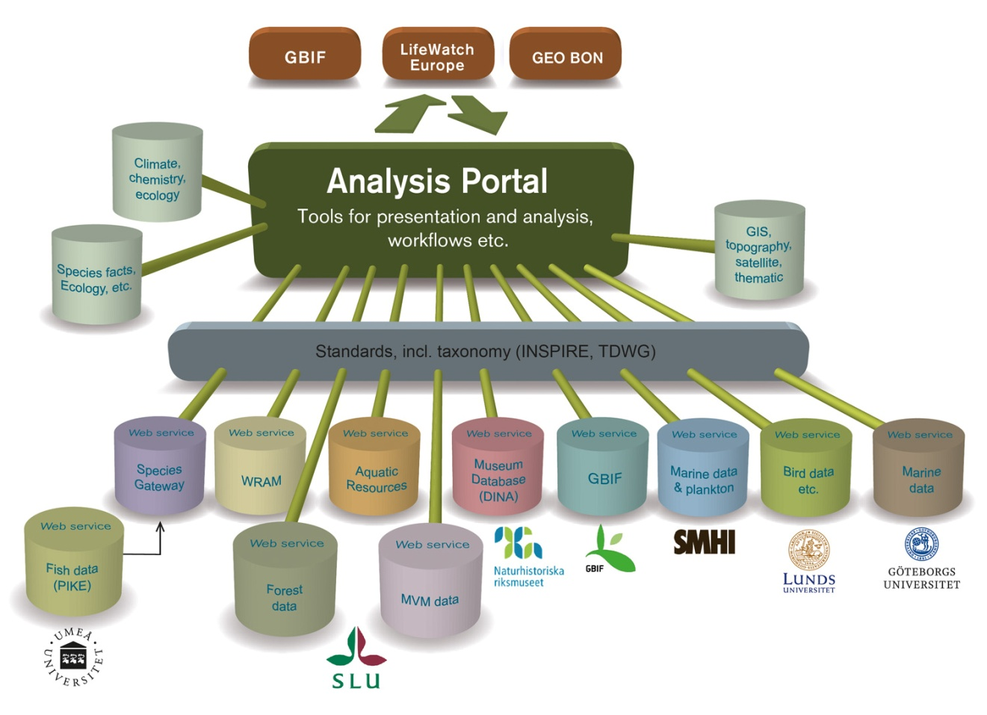
LifeWatch Architecture

Slide 12
Work Package 4
ACTION 4.1
Best practises, management and valorization of natural resources
DELIVERABLE
List and related sheet of best practices & Guidelines for the management and valorization of protected areas
CONTRIBUTION TO DELIBERABLE
Coordination of and collection of best practices Identification of common strategies and coordination among partners & Survey of the existing documents, updating of the of the guidelines with the latest information, drafting of guidelines
ACTION 4.2
Realization of a decision-makers support tool for the management, for the assessment and prevention of emerging risks and for suggesting solutions in conflicts in land use, with particular attention to protected areas
DELIVERABLE
Project of the common decision-makers support tool
CONTRIBUTION TO DELIBERABLE
Decision-makers support tool design
ACTION 4.3
DELIVERABLE
Geo-referenced maps about the livestock products origin, their description and correspondent recommendations
CONTRIBUTION TO DELIBERABLE
Organizing the production of geo-referenced maps about livestock products origin and biodiversity issues, collecting related studies
Developing geo-referenced maps about naturalistic values and livestock products origin, their description and producing recommendations on safeguarding and touristic exploitation of the territory

Slide 13
BIG Workflow
DATA CLEANING
Workflow Inputs
List of Species
Query_Tools
Taxonomical Databases
Check Taxonomy
Clean Sintax Errors
Clean Semantical Errors
Workflow Outputs
Knowledge Base
DATA ANALYSIS
Workflow Inputs
List of Species
Query_Tools
Geospatial Tools
Statistical Tools
Collaboration Area
Workflow Outputs
Temathic Maps
Data and Graphics
Publications

Slide 14
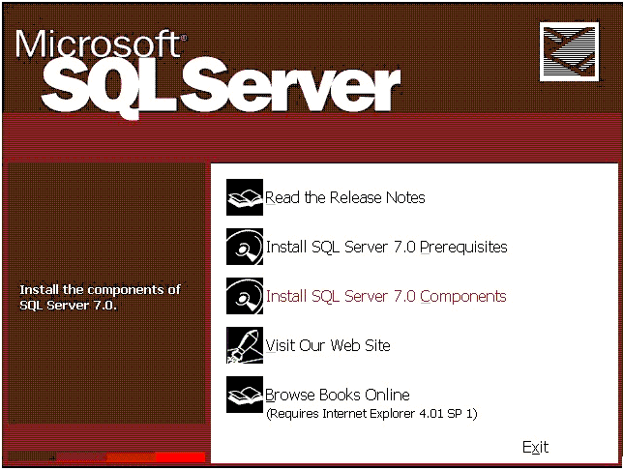
Interoperability & Quality
Input
DATA PROVIDERS
(citizens/researchers)
INTEROPERABILITY
STANSTARD/TOOLS
DATA CLEANING
Output
KNOWLEGDE
BASE
ABCD DARWIN CORE
BIOCASE
Knowledge Base
www.faunaeur.org
www.fishbase.org
www.algaebase.org
www.actaplantarum.org
www.ittiofauna.org
www.eunis.org

Slide 15
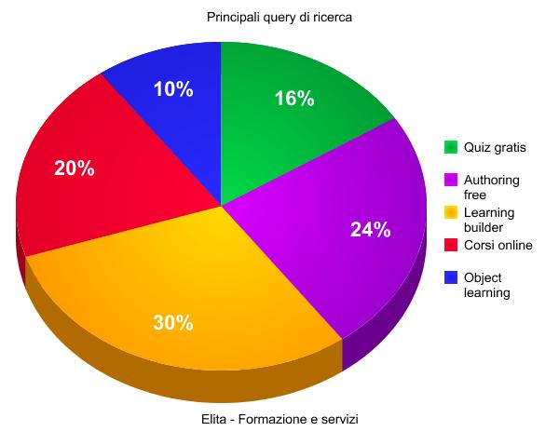
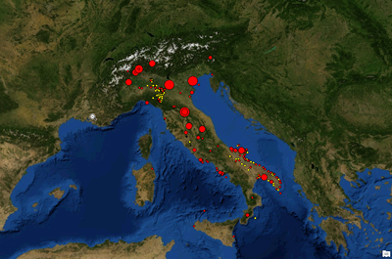
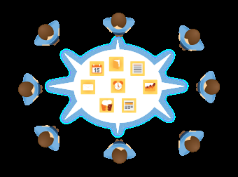
Decision-makers support tool for the management of protected areas
Input
KNOWLEGDE
BASE
Statistical/Modelling Tools
Output
KNOWLEGDE
Knowledge Base
Geospatial Tools
Collaboration Area
Collaboration Area

Slide 16
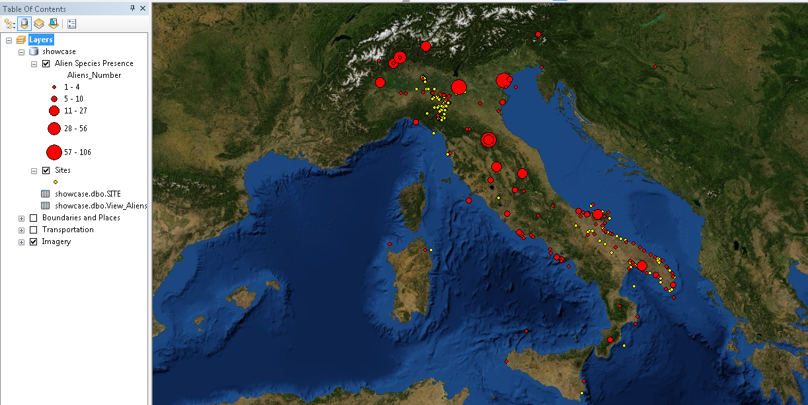
Alien Species case - DSS G.I.S. View

Slide 17
Work Package 4
ACTION 4.4
Training for the requalification of the professional profile of managers of protected areas
DELIVERABLE
Report of the training course for the requalification of professional profile of managers of protected areas
CONTRIBUTION TO DELIBERABLE
Organization and implementation of the training course(1 week), collection of the signatures lists, drawing up the final report. N. 16 participants

Slide 18
Work Package 5
ACTION 5.2
Pilot action about monitoring and management of cliffs and caves in Parco Otranto – S. Maria Leuca e bosco di Tricase (IT-2) and realization and implementation of a laboratory for coastal and marine biodiversity monitoring
DELIVERABLE
Report of the implementation of the pilot action in IT (2)
CONTRIBUTION TO DELIBERABLE
Coastal monitoring (e.g. diving cases, etc.)
Blue Trails and Biodiversity Laboratory

Slide 19
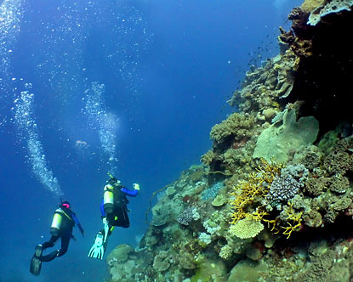
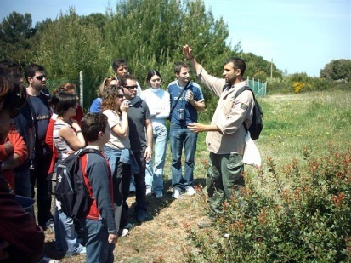
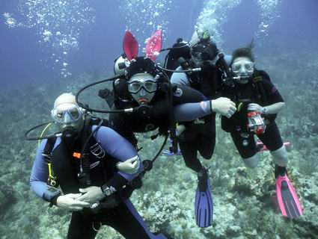
Blue trails
Today, diving tourism is widely recognized an important and expanding tourism market representing one of the most important economic source for all Marine Protected Areas (MPAs) around the world.
The increasing establishment of MPAs, which recently characterized the Italian coasts, has supported to generate in the visitors a strong interest towards marine biology and ecology and thus an exponential growth of underwater naturalistic tourism.
The birth of an "intelligent tourism" has led the Managing Bodies of MPAs to make available the MPAs through the creation of underwater trails, or blue trails, in sites characterized by peculiar natural features. The aim of this initiatives is to carry out alternative forms of recreational activities (such as sea-watching, scuba diving) in order to perform a proper environmental education meeting user needs.
The valorisation of underwater natural emergencies through the implementation of "blue trails" is an effective way to carry out a penetrating environmental education activity, ensuring at the same time the protection of the environment. It represents a concrete example of sustainable development of underwater tourism activities.

Slide 20
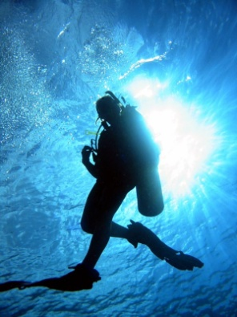
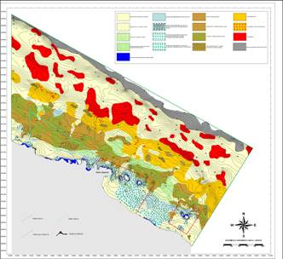
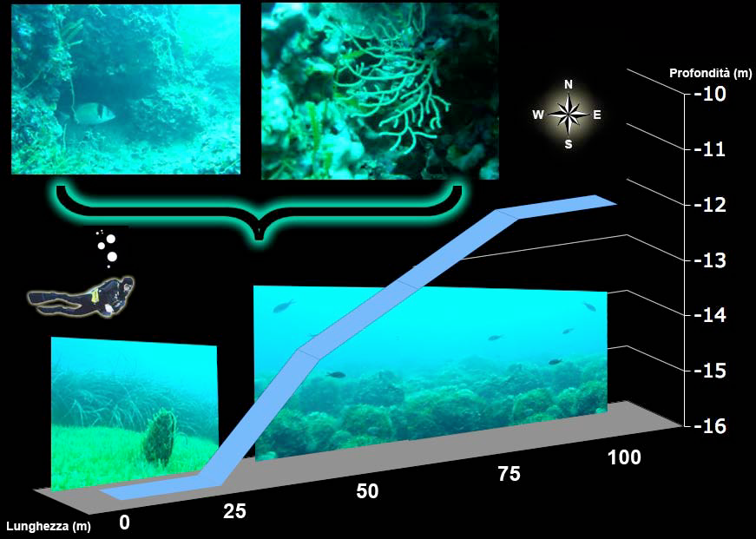
Scuba diving trails for people of all ages
Different steps:
surveys of the seabed: information regarding the distribution of habitats is often essential in order to identify potential areas of greatest interest for users (scuba divers) and people that are not used to dive.
Data collection by video:
High definition videos will be carried out together with a detailed description of what the divers (or the people outside) can see along the trail.
Restitution to the public
within the Marine Laboratory of Tricase the movies of the underwater trails will be available so that people of all ages can follow and understand the importance and the beauty of marine biodiversity.

Slide 21
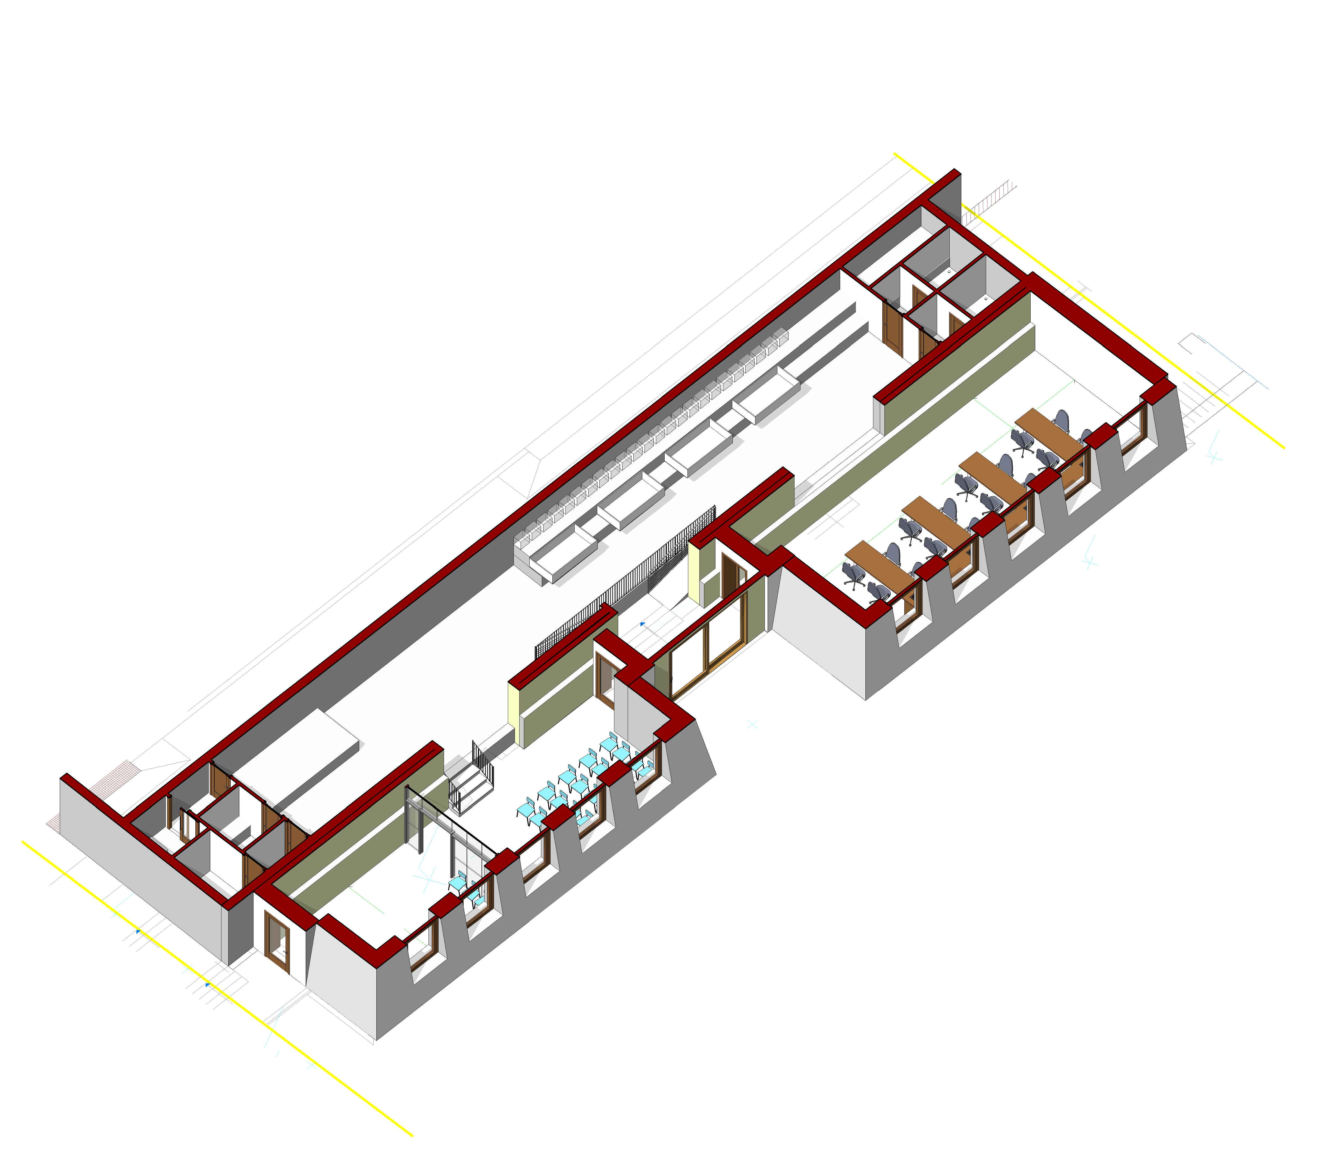
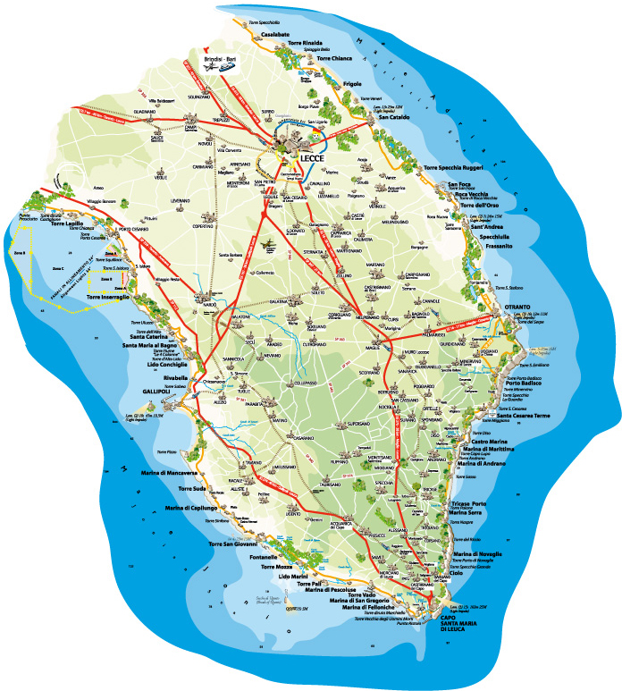
New Marine Laboratory in Tricase Porto

Slide 22
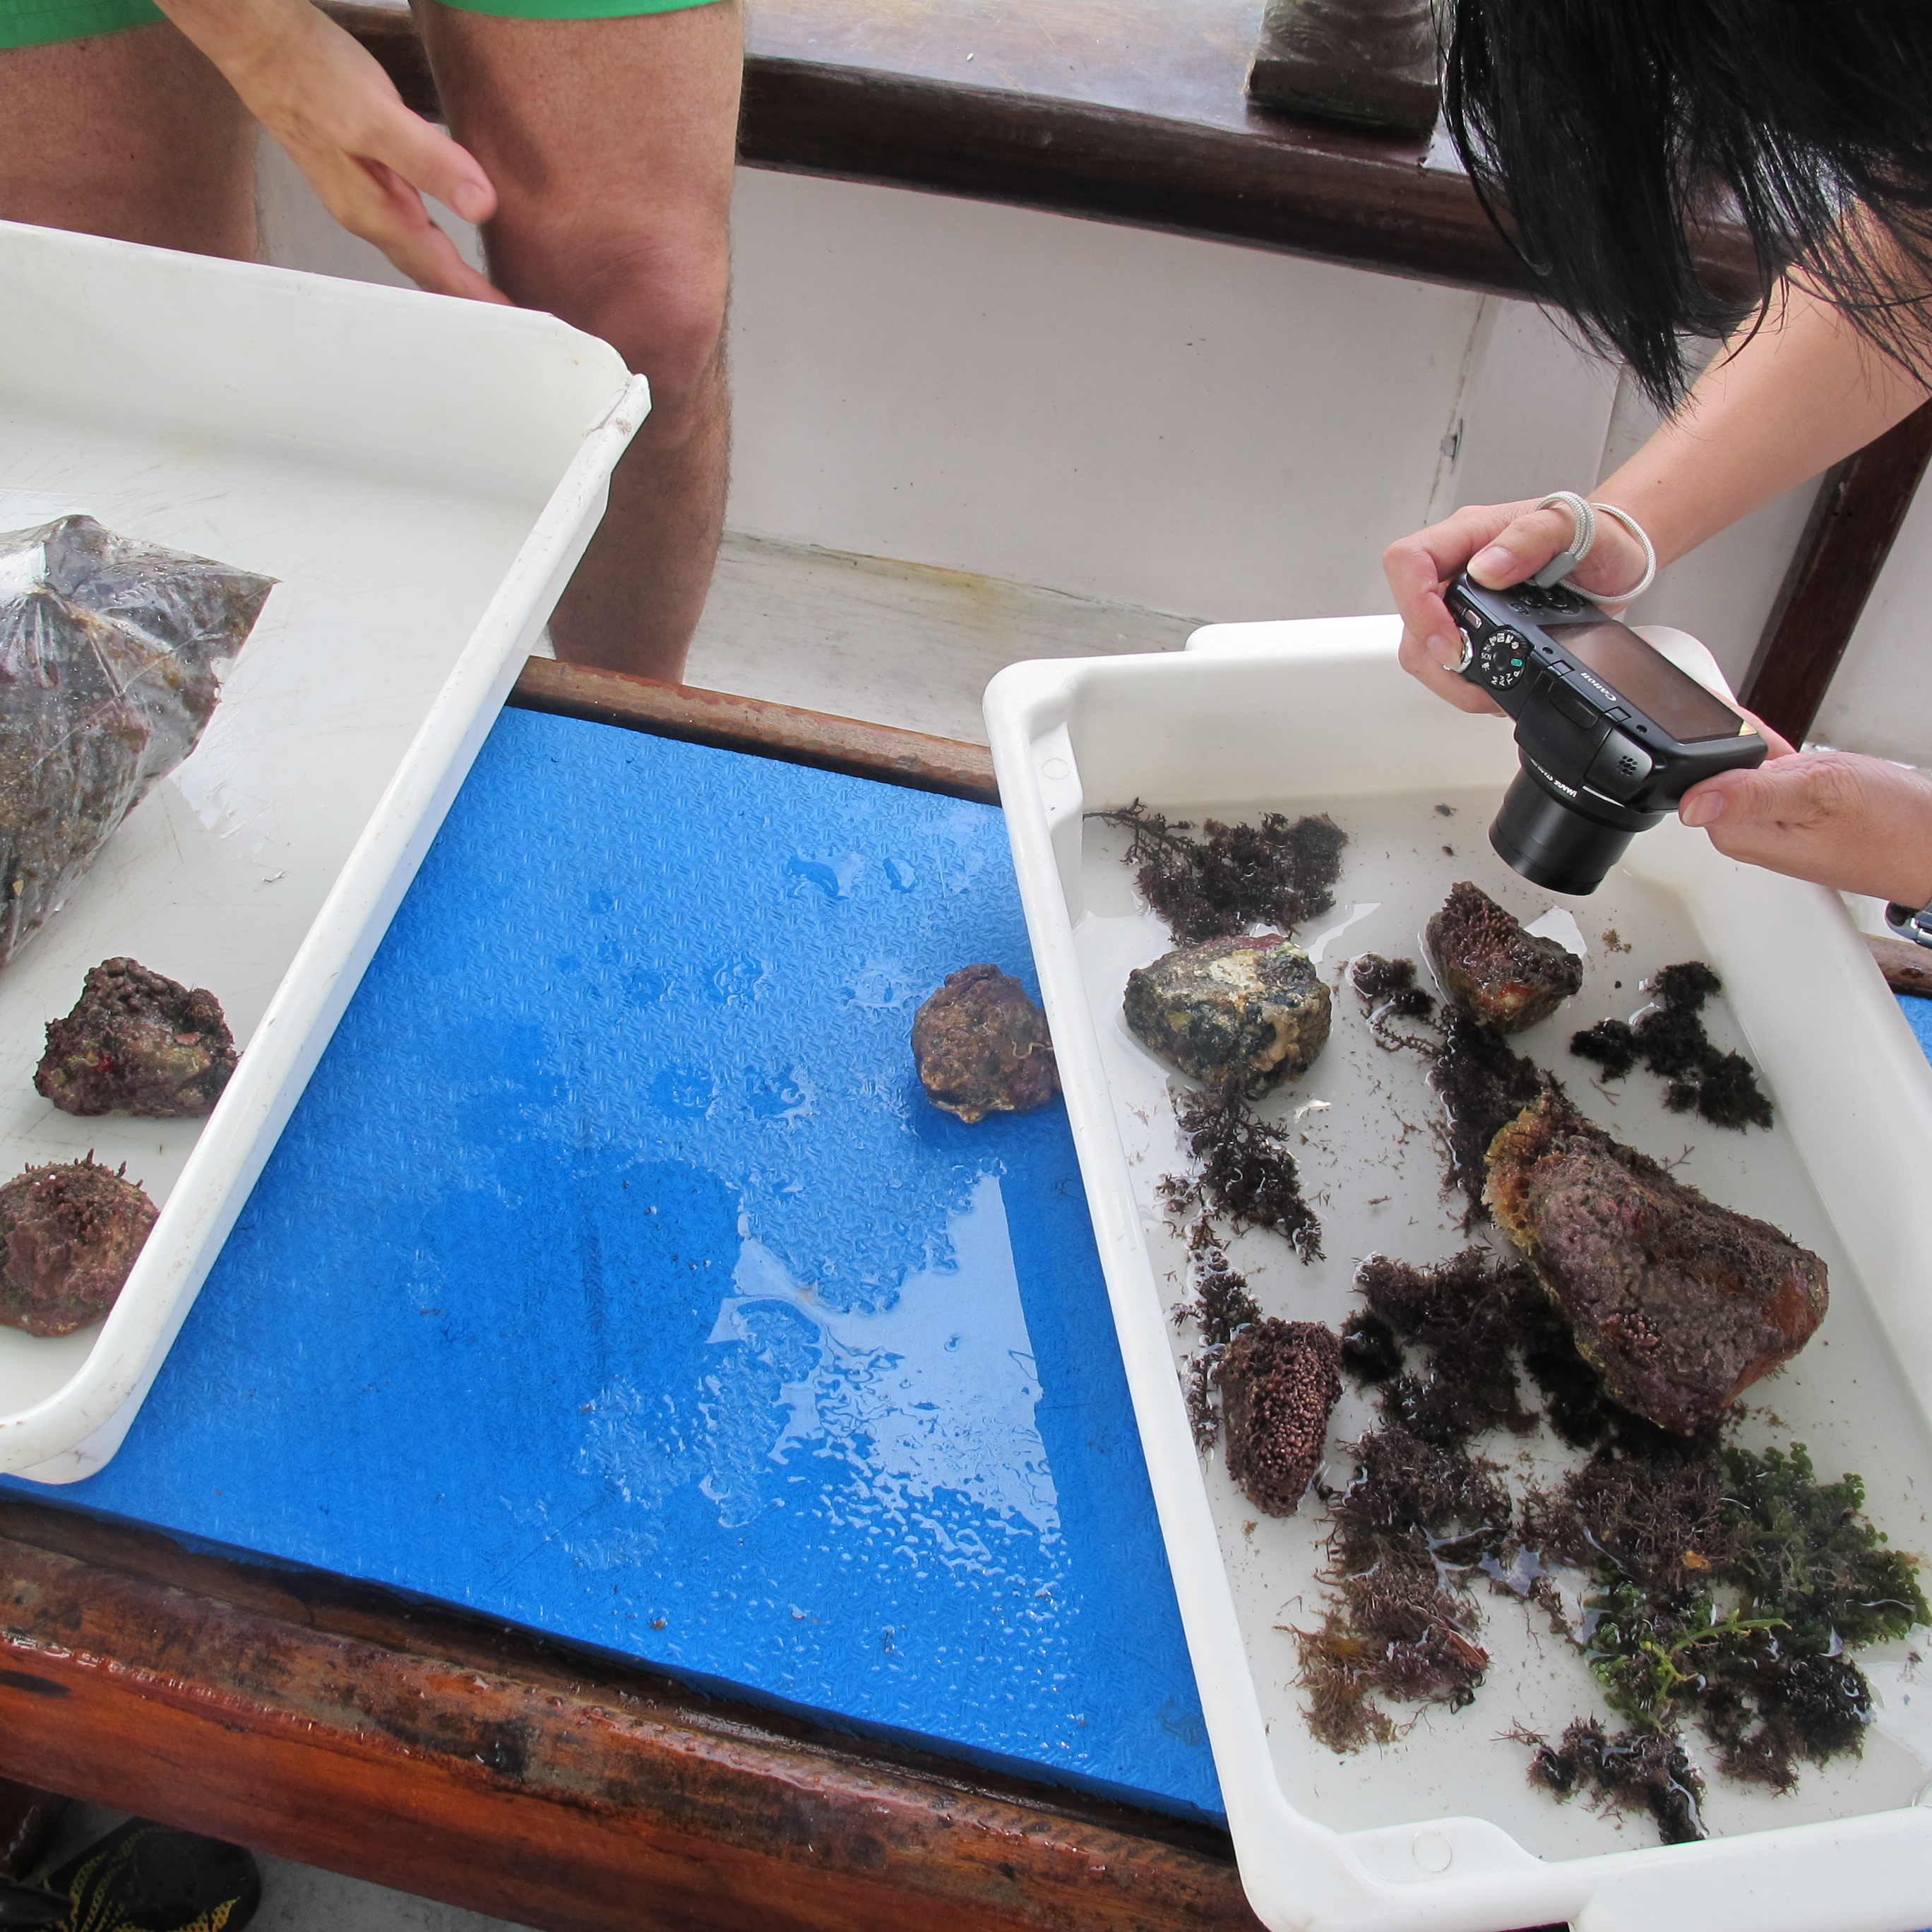
The Marine Lab: research, teaching and outreach
An incredible opportunity to increase and transfer the scientific information from the researches to the public

Slide 23
Thank you!

